Slide 1
PROCESS SYNCHRONIZATION
Course Supervisor: Anaum Hamid
SPRING 2022

Slide 2
Race Condition
A situation where several processes access and manipulate the same data concurrently and the outcome of the execution depends on the particular order in which the access takes place.

Slide 3
Example for Race condition
Suppose a customer wants to book a seat on UAL 56. Ticket agent will check the #-of-seats. If it is greater than 0, he will grab a seat and decrement #-of-seats by 1.
UAL 56:#-of-seats=12
Main memory
…
Terminal
Terminal
Terminal
Ticket Agent 1
Ticket Agent 2
Ticket Agent n

Slide 4
Example for Race condition(cont.)
Ticket Agent 1
P1: LOAD #-of-seats
P2: DEC 1
P3: STORE #-of-seats
Ticket Agent 2
Q1: LOAD #-of-seats
Q2: DEC 1
Q3: STORE #-of-seats
Ticket Agent 3
R1: LOAD #-of-seats
R2: DEC 1
R3: STORE #-of-seats
Suppose instructions are interleaved as P1,Q1,R1,P2,Q2,R2,P3,Q3,R3
To solve the above problem, we must make sure that:
P1,P2,P3 must be completely executed before we execute Q1 or R1, or
Q1,Q2,Q3 must be completely executed before we execute P1 or R1, or
R1,R2,R3 must be completely executed before we execute P1 or Q1.

Slide 5
Critical Section Problem
Consider system of n processes {p₀ , p₁ , … p_{n-1}}
Each process has critical section segment of code
Process may be changing common variables, updating table, writing file, etc.
When one process in critical section, no other may be in its critical section
Critical section problem is to design protocol to solve this
Each process must ask permission to enter critical section in entry section, may follow critical section with exit section, then remainder section

Slide 6
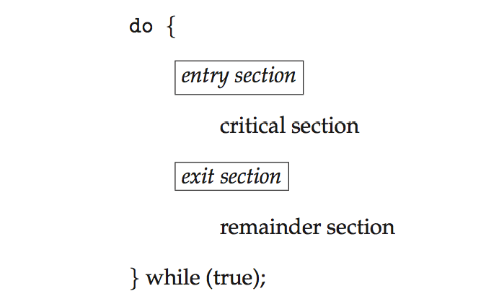
Critical Section
General structure of process P_{i}

Slide 7
The Critical Section/ Region Problem
Occurs in systems where multiple processes all compete for the use of shared data.
Each process includes a section of code (the critical section) where it accesses this shared data.
The problem is to ensure that only one process at a time is allowed to be operating in its critical section.

Slide 8
Critical Regions (1)
Conditions required to avoid race condition:
No two processes may be simultaneously inside their critical regions.
No assumptions may be made about speeds or the number of CPUs.
No process running outside its critical region may block other processes.
No process should have to wait forever to enter its critical region.

Slide 9
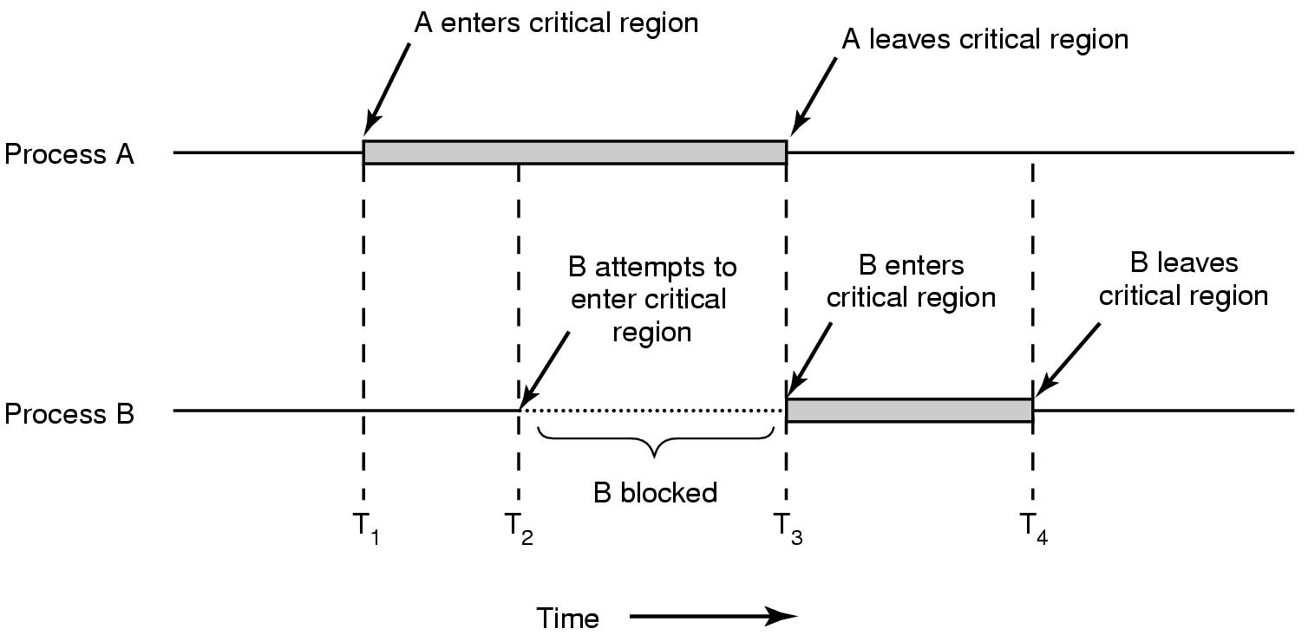
Critical Regions (2)
Mutual exclusion using critical regions.

Slide 10
Critical-Section Problem (Cont.)
Requirements for solution to critical-section problem
Mutual Exclusion - If process P_{i} is executing in its critical section, then no other processes can be executing in their critical sections.
Progress - If no process is executing in its critical section and there exist some processes that wish to enter their critical section, then the selection of the process that will enter the critical section next cannot be postponed indefinitely.
Bounded Waiting - A bound must exist on the number of times that other processes can enter their critical sections after a process has made a request to enter its critical section and before that request is granted.
Assume that each process executes at a nonzero speed
No assumption concerning relative speed of the n processes

Slide 11
Critical-Section Handling in OS
Two approaches depending on if kernel is preemptive or non- preemptive
Preemptive – allows preemption of process when running in kernel mode
Non-preemptive – runs until exits kernel mode, blocks, or voluntarily yields CPU
Essentially free of race conditions in kernel mode

Slide 12
Peterson’s Solution
Two process solution.
Assume that the load and store machine-language instructions are atomic; that is, cannot be interrupted.
The two processes share two variables:
int turn;
boolean flag[2]
The variable turn indicates whose turn it is to enter the critical section.
The flag array is used to indicate if a process is ready to enter the critical section.
flag[i] = true implies that process P_{i} is ready!

Slide 13
Algorithm for Process P_{i}
while (true){
flag[i] = true;
turn = j;
while (flag[j] && turn = = j)
;
/* critical section */
flag[i] = false;
/* remainder section */
}

Slide 14
Correctness of Peterson’s Solution
Provable that the three CS requirement are met:
1. Mutual exclusion is preserved
P_{i} enters CS only if:
either flag[j] = false or turn = i
2. Progress requirement is satisfied
3. Bounded-waiting requirement is met

Slide 15
Peterson’s Solution and Modern Architecture
Although useful for demonstrating an algorithm, Peterson’s Solution is not guaranteed to work on modern architectures.
To improve performance, processors and/or compilers may reorder operations that have no dependencies.
Understanding why it will not work is useful for better understanding race conditions.
For single-threaded this is ok as the result will always be the same.
For multithreaded the reordering may produce inconsistent or unexpected results!

Slide 16
Modern Architecture Example
Two threads share the data:
boolean flag = false; int x = 0;
Thread 1 performs while (!flag) ; print x
Thread 2 performs x = 100; flag = true
What is the expected output?
100

Slide 17
Modern Architecture Example (Cont.)
However, since the variables flag and x are independent of each other, the instructions:
flag = true; x = 100;
for Thread 2 may be reordered
If this occurs, the output may be 0!

Slide 18
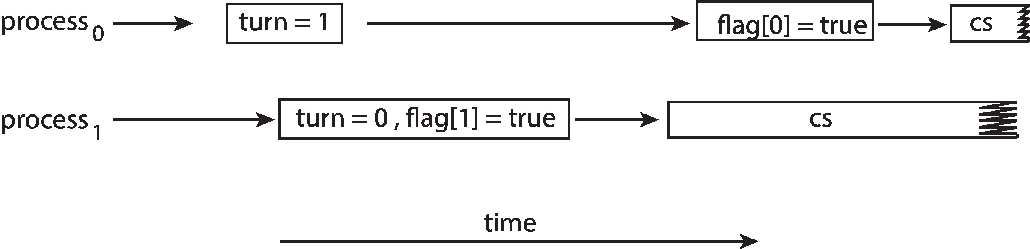
Peterson’s Solution Revisited
The effects of instruction reordering in Peterson’s Solution
This allows both processes to be in their critical section at the same time!
To ensure that Peterson’s solution will work correctly on modern computer architecture we must use Memory Barrier.

Slide 19
Memory Barrier
A MEMORY BARRIER is an instruction that forces any change in memory to be propagated (made visible) to all other processors.
Memory model are the memory guarantees a computer architecture makes to application programs.
Memory models may be either:
Strongly ordered – where a memory modification of one processor is immediately visible to all other processors.
Weakly ordered – where a memory modification of one processor may not be immediately visible to all other processors.

Slide 20
Memory Barrier Instructions
When a memory barrier instruction is performed, the system ensures that all loads and stores are completed before any subsequent load or store operations are performed.
Therefore, even if instructions were reordered, the memory barrier ensures that the store operations are completed in memory and visible to other processors before future load or store operations are performed.

Slide 21
Memory Barrier Example
Returning to the example of slides 16 and 17
We could add a memory barrier to the following instructions to ensure Thread 1 outputs 100:
For Thread 1 we are guaranteed that that the value of flag is loaded before the value of x.
For Thread 2 we ensure that the assignment to x occurs before the assignment flag.
Thread 1 now performs while (!flag) memory_barrier(); print x
Thread 2 now performs x = 100; memory_barrier(); flag = true

Slide 22
Synchronization Hardware
Many systems provide hardware support for implementing the critical section code.
Uniprocessors – could disable interrupts
Currently running code would execute without preemption
Generally, too inefficient on multiprocessor systems.
Operating systems using this not broadly scalable.
We will look at three forms of hardware support: 1. Hardware instructions 2. Atomic variables

Slide 23
Hardware Instructions
Special hardware instructions that allow us to either test-and-modify the content of a word, or two swap the contents of two words atomically (uninterruptedly.)
Test-and-Set instruction
Compare-and-Swap instruction

Slide 24
The test_and_set Instruction
Definition
boolean test_and_set (boolean *target)
{
boolean rv = *target;
*target = true;
return rv:
}
Properties
Executed atomically
Returns the original value of passed parameter
Set the new value of passed parameter to true

Slide 25
Solution Using test_and_set()
Shared boolean variable lock, initialized to false
Solution:
do { while (test_and_set(&lock))
; /* do nothing */
/* critical section */
lock = false;
/* remainder section */
} while (true);
Does it solve the critical-section problem?

Slide 26
The compare_and_swap Instruction
Definition
int compare_and_swap(int *value, int expected, int new_value)
{
int temp = *value;
if (*value == expected)
*value = new_value;
return temp;
}
Properties
Executed atomically
Returns the original value of passed parameter value
Set the variable value the value of the passed parameter new_value but only if *value == expected is true. That is, the swap takes place only under this condition.

Slide 27
Solution using compare_and_swap
Shared integer lock initialized to 0;
Solution:
while (true){ while (compare_and_swap(&lock, 0, 1) != 0)
; /* do nothing */
/* critical section */
lock = 0;
/* remainder section */
}
Does it solve the critical-section problem?

Slide 28
Atomic Variables
Typically, instructions such as compare-and-swap are used as building blocks for other synchronization tools.
One tool is an atomic variable that provides atomic (uninterruptible) updates on basic data types such as integers and booleans.

Slide 29
Mutex Locks
OS designers build software tools to solve critical section problem.
Simplest is mutex lock
Boolean variable indicating if lock is available or not
Protect a critical section by
First acquire() a lock
Then release() the lock
Calls to acquire() and release() must be atomic
Usually implemented via hardware atomic instructions such as compare-and-swap.
Busy Waiting means busy-looping or spinning is a technique in which a process repeatedly checks to see if a condition is true, such as whether keyboard input or a lock is available
Mutex lock therefore called a spinlock

Slide 30
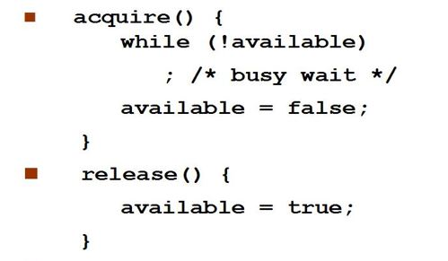
Solution to CS Problem Using Mutex Locks
while (true) {
acquire lock
critical section
release lock
remainder section
}

Slide 31

Pthreads Synchronization – Mutex Lock
#include<pthread.h>
Pthread_mutex_t mutex;
/* create the mutex lock */ Pthread_mutex_ init(&mutex, NULL);
1st Arg: Mutex initiliazer
2nd Arg: Attributes, NULL means no error checks will be performed

Slide 32

Pthreads Synchronization – Mutex Lock
The mutex is acquired with the pthread_mutex_lock()
and released pthread_mutex_unlock() functions.
If the mutex lock is unavailable when pthread_ mutex_lock() is invoked, the calling thread is blocked until the owner invokes pthread_mutex_ unlock().

Slide 33
Semaphore
Semaphore is a variable or abstract data type used to control access to a common resource by multiple processes in a concurrent system such as a multiprogramming operating system.
Synchronization tool that provides more sophisticated ways (than Mutex locks) for processes to synchronize their activities.

Slide 34
Semaphore
Synchronization tool that does not require busy waiting
Semaphore S – integer variable
Two standard operations modify S: wait() and signal()
Less complicated
Can only be accessed via two indivisible (atomic) operations
Definition of wait() operation:
wait (S) {
while (S <= 0)
; // busy wait
S--;
}
Definition of signal() operation:
signal (S) {
S++;
}
when one process modifies the semaphore value, no other process can simultaneously modify that same semaphore value.

Slide 35
Semaphore (Cont.)
Counting semaphore – integer value can range over an unrestricted domain.
Binary semaphore – integer value can range only between 0 and 1
Same as a mutex lock
Can implement a counting semaphore S as a binary semaphore
With semaphores we can solve various synchronization problems like resource allocation, order of execution among processes.

Slide 36
Semaphore Usage
□ consider two concurrently running processes: P1 with a statement S2.
with a statement S1 and P2
□ It is required that S2 be executed only after S1 has completed. We can implement this scheme readily by letting P1and P2 share a common semaphore synch, initialized to 0.
Sem Synch = 0
P1:
S₁;
signal(synch);
P2:
wait(sync); S₂;
□ Because synch is initialized to 0, P2 will execute S2 only after P1 has invoked signal(synch), which is after statement S1 has been executed.

Slide 37
Semaphore Implementation
Must guarantee that no two processes can execute the wait() and signal() on the same semaphore at the same time.
Thus, the implementation becomes the critical section problem where the wait and signal code are placed in the critical section.
Could now have busy waiting in critical section implementation
But implementation code is short
Little busy waiting if critical section rarely occupied.
Note that applications may spend lots of time in critical sections and therefore this is not a good solution

Slide 38
Semaphore Implementation with no Busy waiting
With each semaphore there is an associated waiting queue.
Each entry in a waiting queue has two data items:
Value (of type integer)
Pointer to next record in the list.
Two operations:
block – place the process invoking the operation on the appropriate waiting queue
wakeup – remove one of processes in the waiting queue and place it in the ready queue

Slide 39
Implementation with no Busy waiting (Cont.)
wait(semaphore *S) {
S->value--;
if (S->value < 0) { add this process to S->list;
block();
}
}
signal(semaphore *S) {
S->value++;
if (S->value <= 0) { remove a process P from S->list;
wakeup(P);
}
}

Slide 40
POSIX - Semaphores
#include<semaphore.h> Sem_t sem;
/* Create the semaphore and initialize it to 1 */ Sem_init(&sem, 0, 1);
The sem_init() function is passed three parameters:
A pointer to the semaphore
A flag indicating the level of sharing
The semaphore’s initial value
/* acquire the semaphore */ Sem_wait(&sem);
/* critical section */
/* release the semaphore */ Sem_post(&sem);

Slide 41
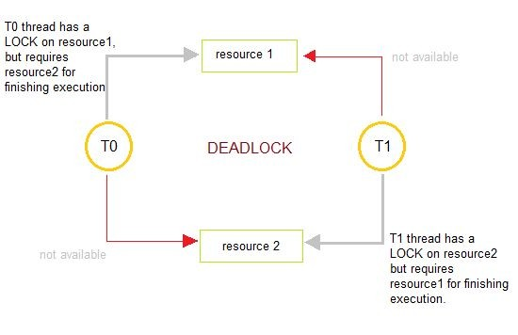
Deadlock
□ Deadlocks are a set of blocked
processes each holding a resource and waiting to acquire a resource held by another process

Slide 42
Starvation
□ Starvation is the name given to the indefinite postponement of a process because it requires some resource before it can run, but the resource, though available for allocation, is never allocated to this process.

Slide 43
Deadlock Vs. Starvation
Deadlock refers to the situation when processes are stuck in circular waiting for the resources.
On the other hand, starvation occurs when a process waits for a resource indefinitely.
Deadlock implies starvation but starvation does not imply deadlock

Slide 44
Priority Inversion
Priority Inversion – Scheduling problem when lower-priority process holds a lock needed by higher-priority process
Solved via priority-inheritance protocol

Slide 45
Priority Inheritance Protocol
when a job blocks one or more high-priority jobs, it ignores its original priority assignment and executes its critical section at an elevated priority level.
After executing its critical section and releasing its locks, the process returns to its original priority level

Slide 46
Classical Problems of Synchronization
□ Classical problems used to test newly-proposed synchronization schemes
Bounded Buffer Problem
Dining-Philosophers Problem
Readers and Writers Problem

Slide 47
Bounded-Buffer Problem
n buffers, each can hold one item
Semaphore mutex initialized to the value 1
Semaphore full initialized to the value 0
Semaphore empty initialized to the value n

Slide 48
Bounded Buffer Problem (Cont.)
The structure of the PRODUCER process
while (true) {
... /* produce an item in next_produced */
...
wait(empty);
wait(mutex);
... /* add next produced to the buffer */
...
signal(mutex);
signal(full);
}

Slide 49
Bounded Buffer Problem (Cont.)
The structure of the CONSUMER process
while (true) {
wait(full);
wait(mutex);
... /* remove an item from buffer to next_consumed */
...
signal(mutex);
signal(empty);
... /* consume the item in next consumed */
... }

Slide 50
Readers-Writers Problem
A data set is shared among several concurrent processes
Readers – only read the data set; they do not perform any updates
Writers – can both read and write
Problem – allow multiple readers to read at the same time
Only one single writer can access the shared data at the same time.
Several variations of how readers and writers are considered – all involve some form of priorities

Slide 51
Readers-Writers Problem (Cont.)
Shared Data
Data set
Semaphore rw_mutex initialized to 1
Semaphore mutex initialized to 1
Integer read_count initialized to 0
Cases: RR, WW, RW, WR

Slide 52
Readers-Writers Problem (Cont.)
The structure of a WRITER process
while (true) { wait(rw_mutex);
... /* writing is performed */
...
signal(rw_mutex);
}

Slide 53
Readers-Writers Problem (Cont.)
The structure of a READER process
while (true){ wait(mutex); read_count++; if (read_count == 1) /* first reader */
wait(rw_mutex);
signal(mutex);
... /* reading is performed */
...
wait(mutex); read count--; if (read_count == 0) /* last reader */
signal(rw_mutex);
signal(mutex);
}

Slide 54

Dining-Philosophers Problem
N philosophers’ sit at a round table with a bowel of rice in the middle.
They spend their lives alternating thinking and eating.
They do not interact with their neighbors.
Occasionally try to pick up 2 chopsticks (one at a time) to eat from bowl
Need both to eat, then release both when done
In the case of 5 philosophers, the shared data
Bowl of rice (data set)
Semaphore chopstick [5] initialized to 1

Slide 55
Dining-Philosophers Solution 1
When a philosopher wants to eat the rice, he will wait for the chopstick at his left and picks up that chopstick.
Then he waits for the right chopstick to be available, and then picks it too. After eating, he puts both the chopsticks down

Slide 56
Dining-Philosophers Problem
□ But if all five philosophers are hungry simultaneously, and each of them pickup one chopstick, then a deadlock situation occurs:

Slide 57
Dining-Philosophers Solution 2
Two Possible solutions are :
A philosopher must be allowed to pick up the chopsticks only if both the left and right chopsticks are available.
Allow only four philosophers to sit at the table. That way, if all the four philosophers pick up four chopsticks, there will be one chopstick left on the table. So, one philosopher can start eating and eventually, two chopsticks will be available. In this way, deadlocks can be avoided.

Slide 58
Dining-Philosophers Problem Algorithm
Semaphore Solution
The structure of Philosopher i:
while (true){
wait (chopStick[ (i + 1) % 5] );
wait (chopstick[i] );
/* eat for awhile */
signal (chopstick[i] );
signal (chopstick[ (i + 1) % 5] );
/* think for awhile */
}

Slide 59
Thank you

